Slide 1
TEAM IMPECCABLES
Aniket Kumar Sahu
A.Neeharika
A.Rohan Sai Chandra
P.Dheeraj Kumar

Slide 2

Theme of Project
Increase sales & promotion of car products. (especially pickups) which is famous in the world but not in India

Slide 3


Problem To Tackle
When it comes to pickup trucks, the buyers often suffer from the judgement complex. As customers don't know about the benefits of pickup trucks.
The marketing and promotions of pick up trucks in India is not as good as compared to foreign countries.

Slide 4

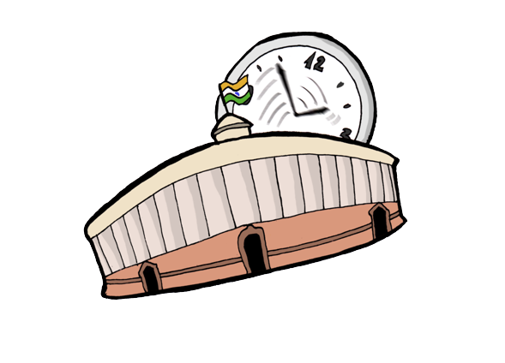
A pickup truck was registered as a commercial vehicle in India with a yellow registration plate and the driver needs to have a commercial vehicle license. Also, being categorized as a commercial vehicle, a pickup truck owner needs to obtain a national permit, if he or she wants to drive around the states.
According to a key Ford India official, it is not Indian tastes that are different, but it is a policy anomaly that is hindering the growth of pickup trucks in India.

Slide 5
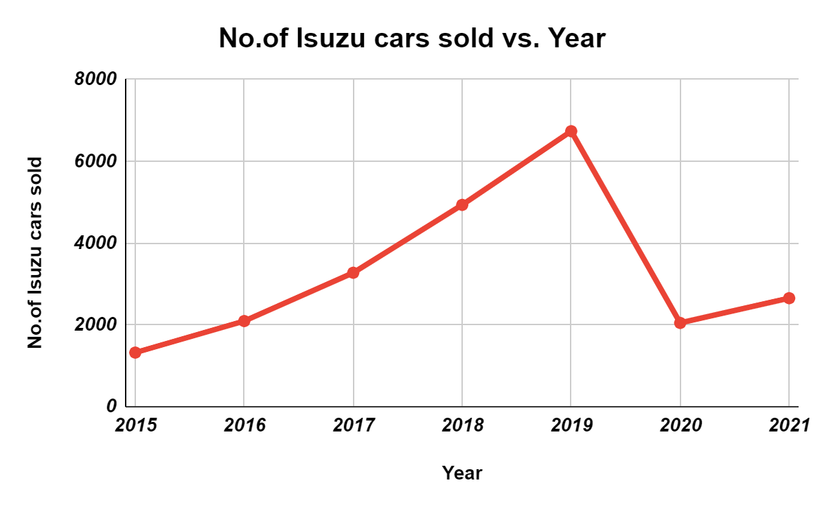

Analysis
Year | YOY growth
2016 | 58.27%
2017 | 56.39%
2018 | 50.65%
2019 | 36.50%
2020 | -69.59%
2021 | 29.54%

Slide 6



Analysis
As we can see the number of sales of isuzu are increasing from year 2015 to 2019 and then there is a huge descend in sales from 2019 to 2020 due to the lockdown in India.
From year 2020 to 2021 there was less increase in sales because of the shortage of electronic control module(ECM) due to pandemic, so manufacturing of vehicles had been reduced

Slide 7

Targeted Audience
URBAN: The reasons for choosing pickup trucks in urban areas are high seating position, rugged build and good visibility while people are stuck in traffic.
While Urban people go for long trips they can use pickup trucks as it is a lot safer and has a lot of boot space.
Upper class : we promote our truck as a symbol of luxury, comfort, featured one among any trucks in India.
Mercedes-Benz G-Class price of Rs. 1.64 Cr
The price of Hummer H3 Rs. 80.0 Lakh.
Ford F-450 (Pickup) Rs 50-60 Lakh
As they get similar specifications car in a lower price
Middle class :
A vacation is an extra expense that many middle-earners cannot afford without sacrificing something else. A Statista survey found in 2014, 54% of people gave up purchasing big ticket items like TVs or electronics, so they could go on a vacation. We can promote our truck as a vehicle which can be used both for daily use and travelling long distances

Slide 8
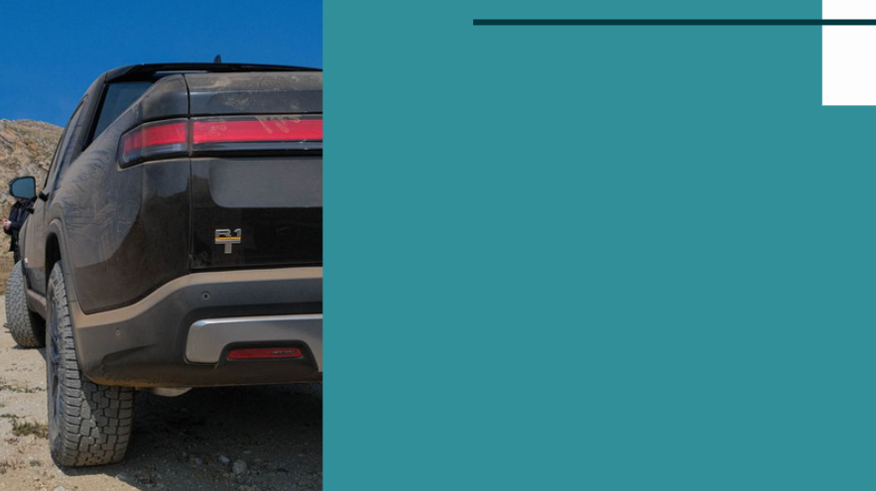
RURAL :
In rural areas most of the people are engaged in farming. As the roads to the rural areas are too narrow,for people to carry their heavy goods to other places, pick-up trucks are the best option. As pickup trucks can carry extra loads using trailers.
Terrain Region:
In hilly areas, not just for goods transfer but also for normal transportation we need a high power vehicle. So we promote our truck as vehicle best for both goods and people transportation.

Slide 9
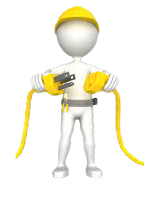
Our Solution
Our salesman can reach the consumers with the necessary VR equipment to the consumer’s doorstep.
Customers will test the interior and exterior of the required vehicle by VR.
By using VR, they will get realistic experience of the design of the vehicle.
Customers can also simulate the vehicle by going to the nearest campaign.

Slide 10
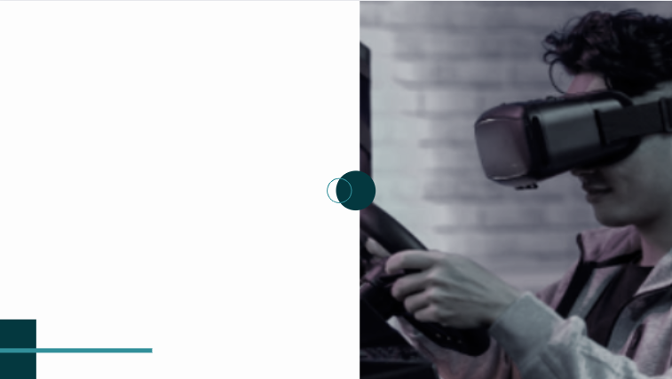
SOLUTION 2
We can also create a VR game and promote our vehicle.
By launching our game people will get to register our brand name and features in their minds. For example the model, power of engine etc.
Teenagers who play this game will get excited to buy the pickup truck in future
Notes:
Ford used a penalty kicks game to promote one of its car models in Sweden. The campaign ran as a mobile web banner. When a user clicked the banner, the game expanded to full screen. Players needed to shoot three penalty kicks through the back door of the car. At the end of the game, they could watch a video and make an appointment to visit a local dealership.

Slide 11

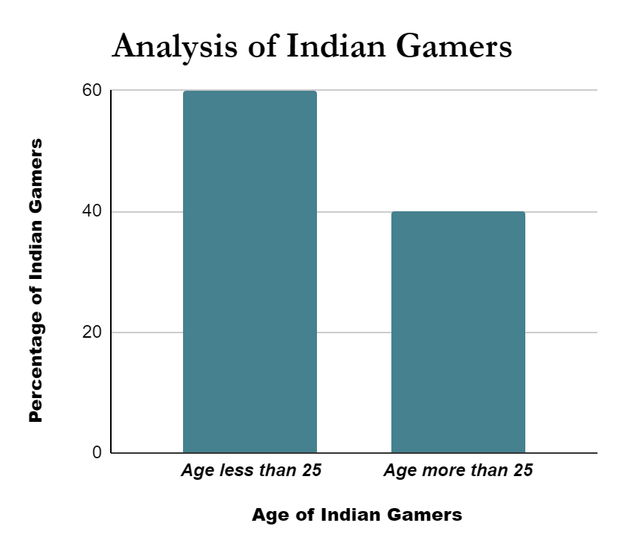
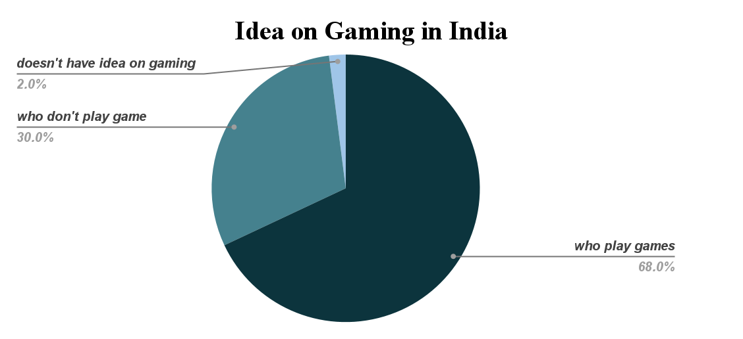
Gaming Analysis

Slide 12
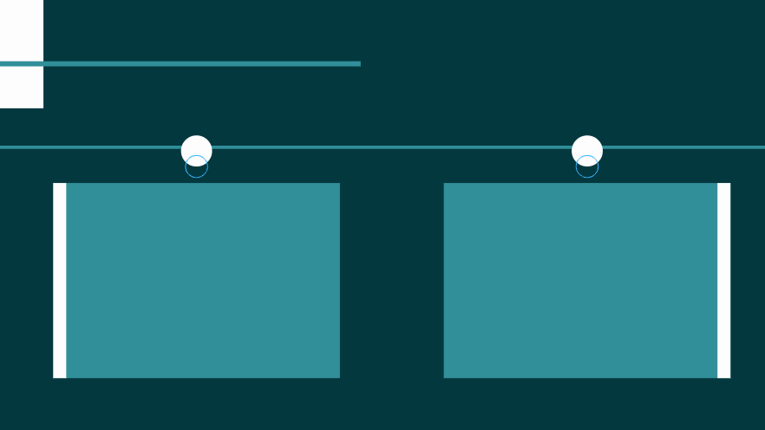
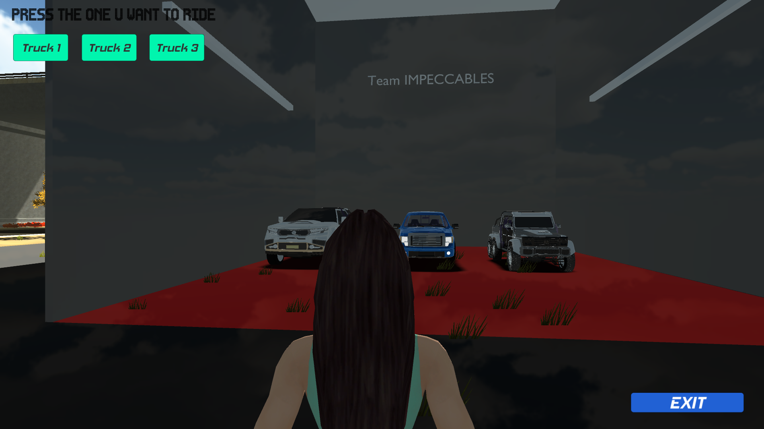
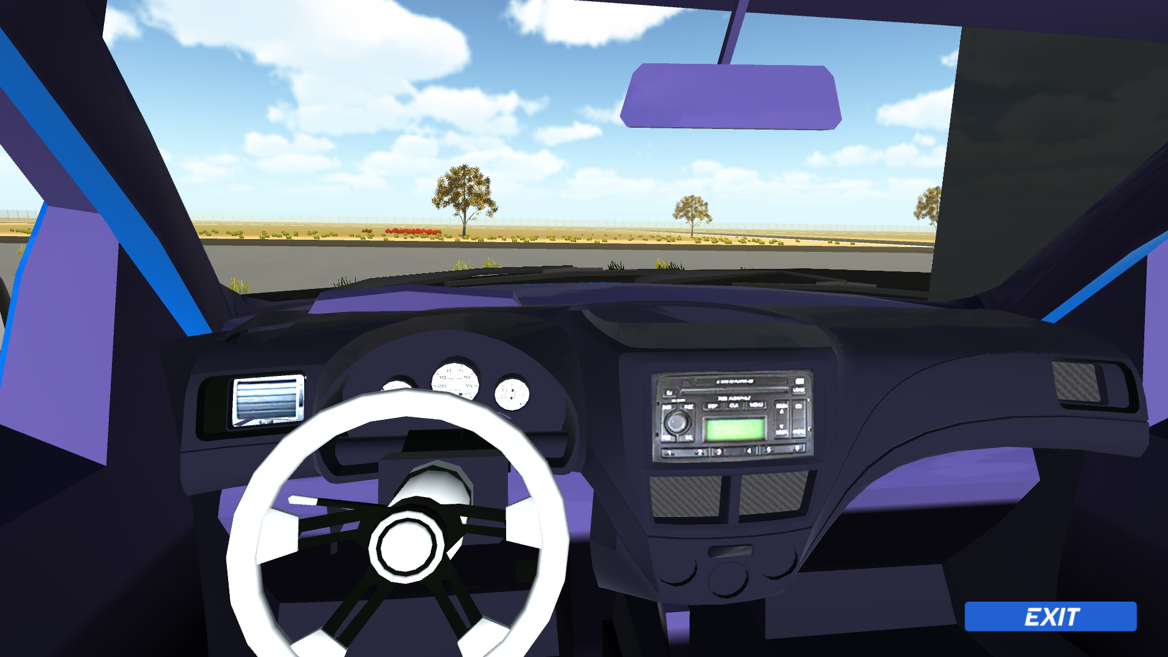
Exterior & Interior Model, Game Video
Video :
https://drive.google.com/file/d/1fPsof3bnO6LjURVrfiX81kbuG7ffksHq/view?usp=sharing

Slide 13
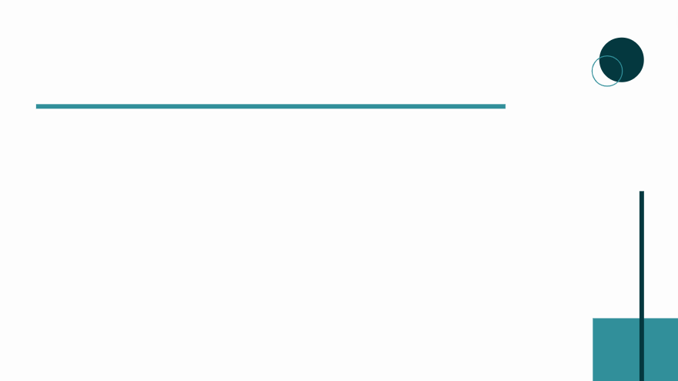
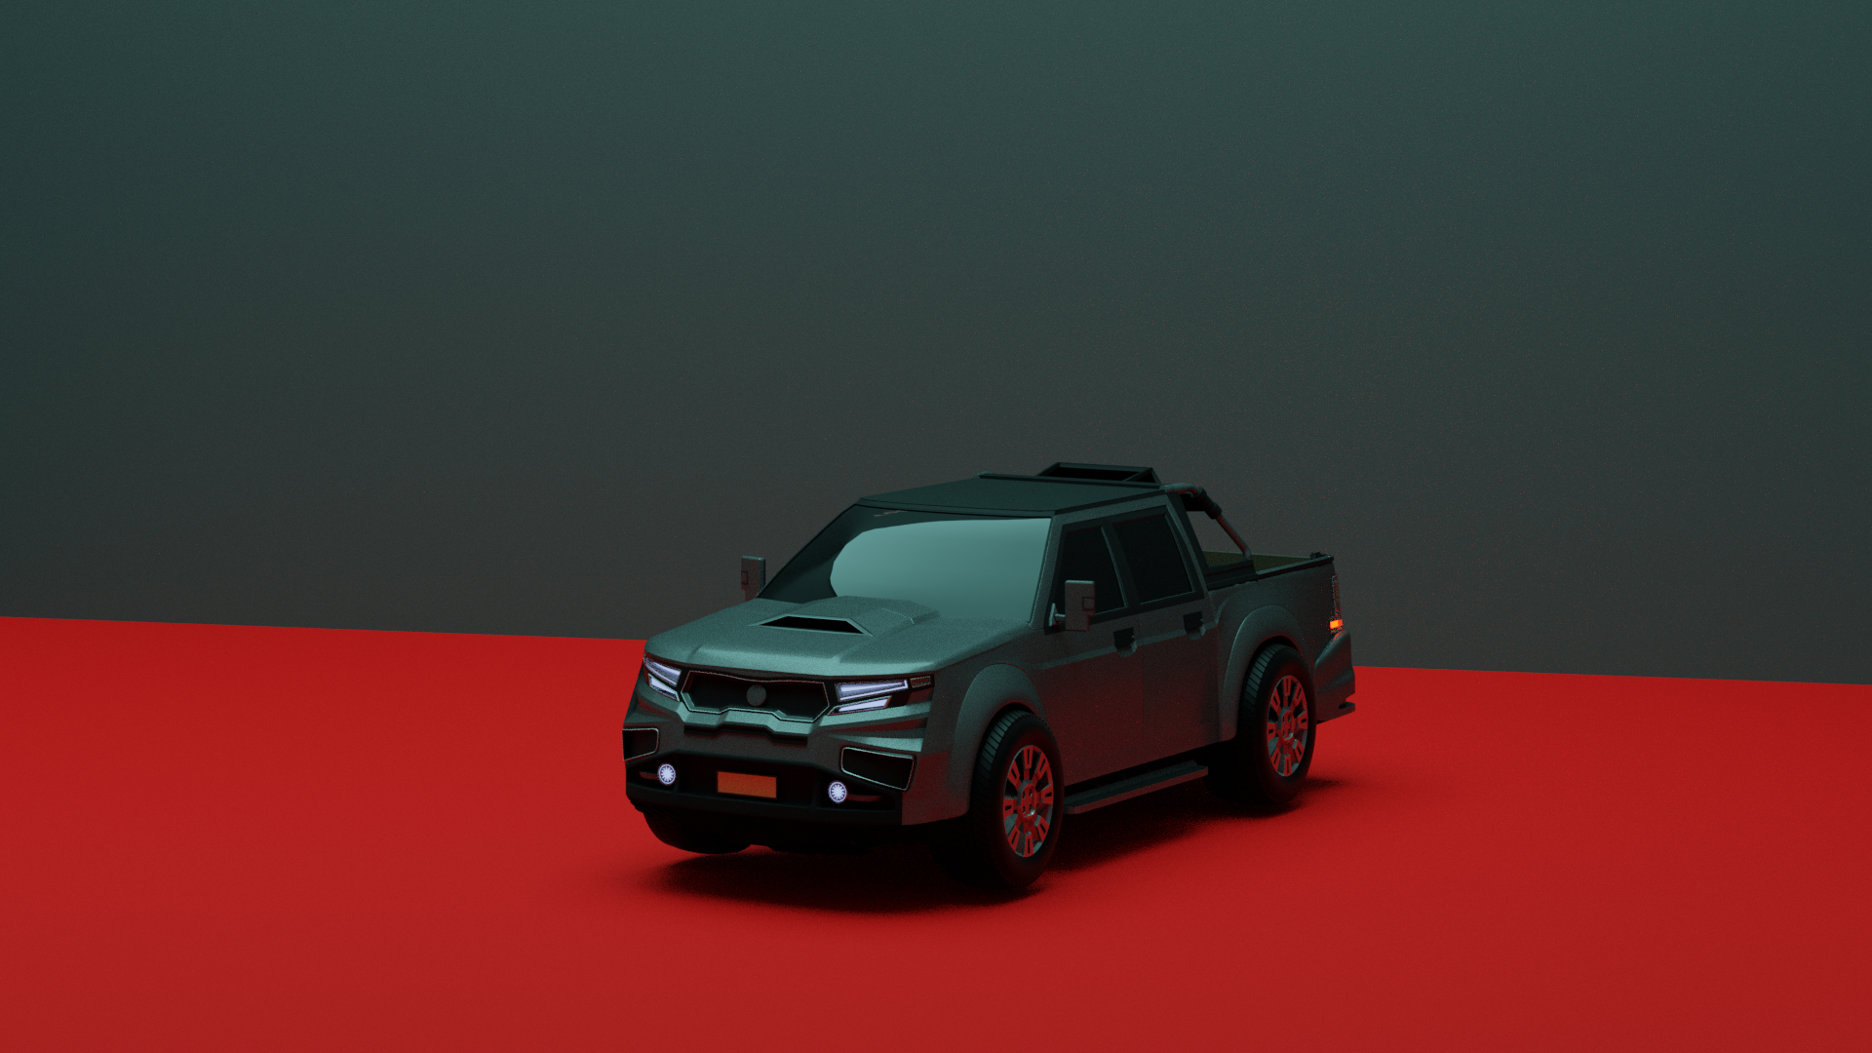
Game Creation
For getting started, Realistic Car Kit is used and then required modifications like chassis, camera, character, showroom, etc. were done
The Models used, are downloaded from cgtrader website and from unity asset store.
Unfortunately we were not able to get access of an oculus, therefore we used a mouse and performed VR operations using mouse

Slide 14

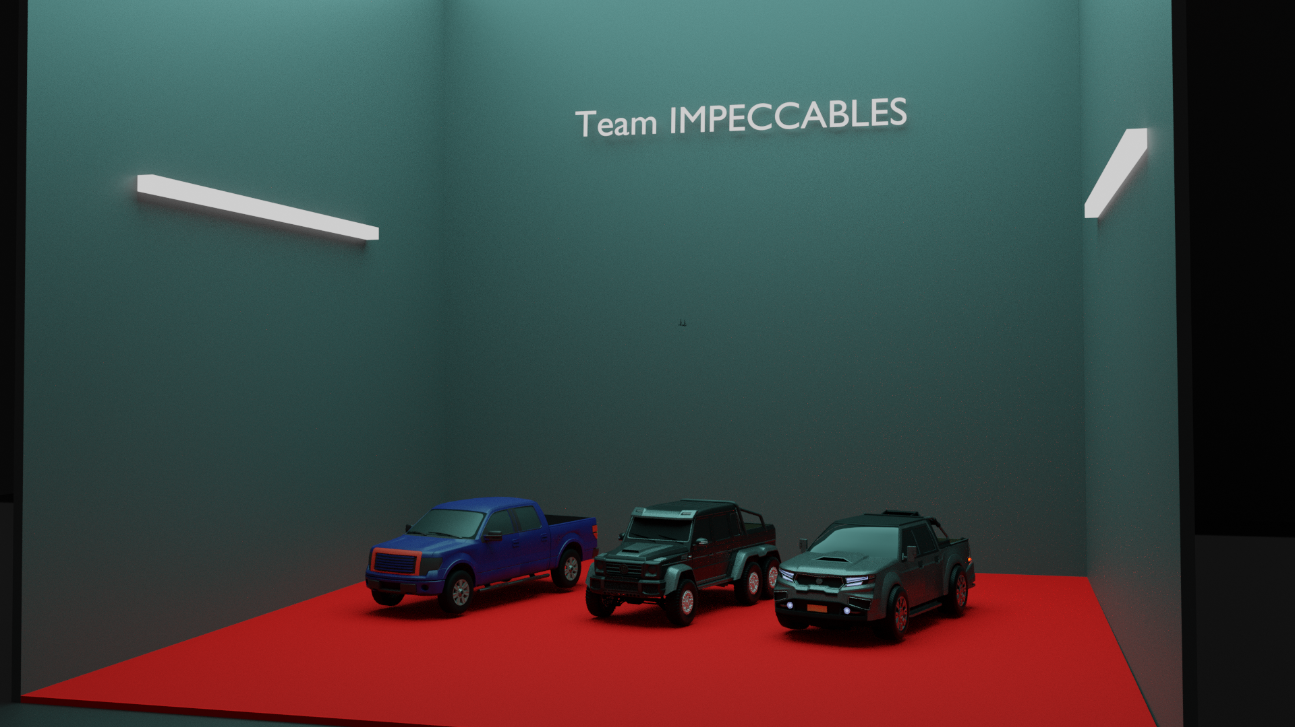
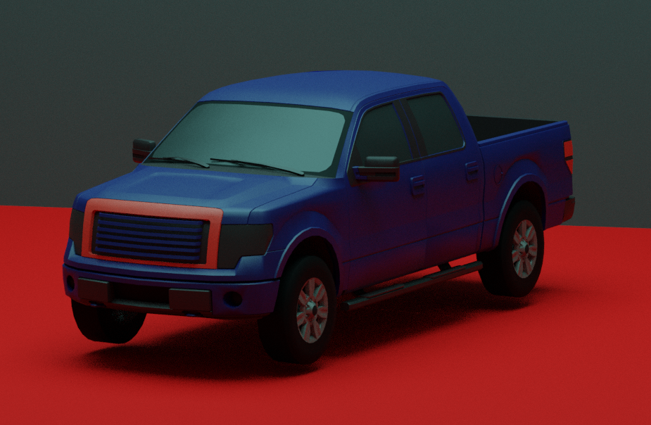
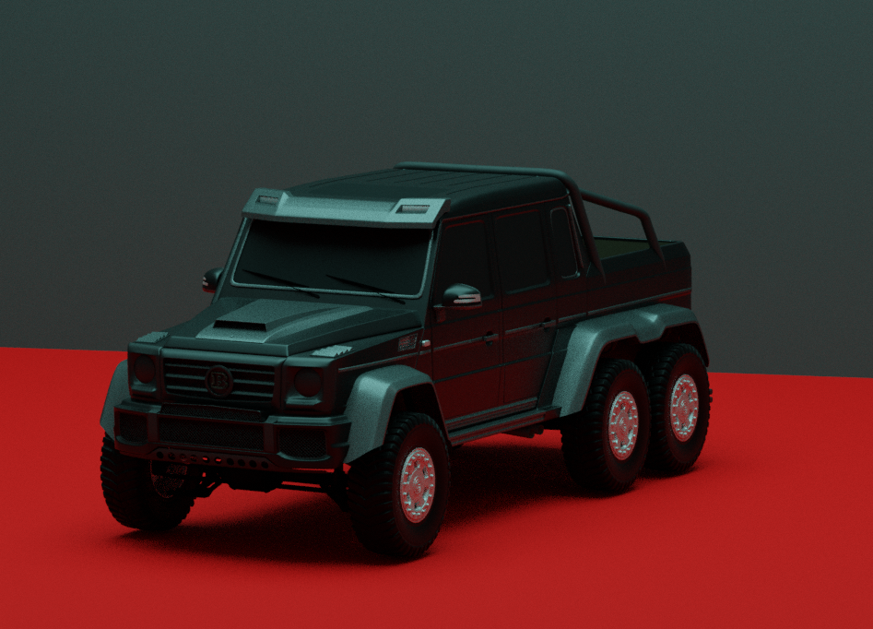
Gallery

Slide 15

Thank You For Listening!

